Slide 1
FUNDAMENTAL ANALYSIS
Dr. Manish Dadhich

Slide 2
What is 'Fundamental Analysis'
Fundamental analysis is a method of evaluating a security in an attempt to measure its intrinsic value, by examining related economic, financial and other qualitative and quantitative factors.
Fundamental analysts study anything that can affect the security's value, including macroeconomic factors
such as the overall economy and industry conditions, and microeconomic factors such as financial conditions and company management.

Slide 3
What is 'Fundamental Analysis'
The end goal of fundamental analysis is to produce a quantitative value that an investor can compare with a security's current price, thus indicating whether the security is undervalued or overvalued.

Slide 4
WHAT IS FUNDAMENTAL ANALYSIS?
Fundamental analysis is the examination of the underlying forces that affect the well being of the economy, industry groups, and companies.
The most common way that fundamental analysis is done in is in three steps:

Slide 5
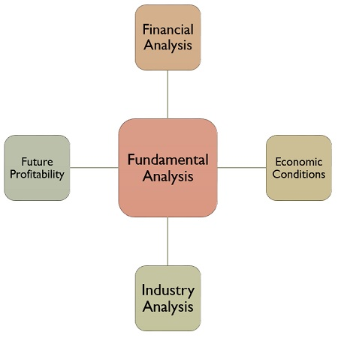

Slide 6
Technical Analysis
Technical Analysis is used to forecast the price of a share, which says that the price of a share of the company is based on the interaction of demand and supply forces, operating in the marketplace.
It is used to forecast the future market price of the stock, as per the past performance statistics of the share. For this purpose, first of all, the changes in the price of the stock are ascertained, to know how the price will change in future.

Slide 7
BASIS FOR COMPARISON | FUNDAMENTAL ANALYSIS | TECHNICAL ANALYSIS
Meaning | Fundamental Analysis is a practice of analyzing securities by determining the intrinsic value of the stock. | Technical analysis is a method of determining the future price of the stock using charts to identify the patterns and trends.
Relevant for | Long term investments | Short term investments
Function | Investing | Trading
Objective | To identify the intrinsic value of the stock. | To identify the right time to enter or exit the market.
Decision making | Decisions are based on the information available and statistic evaluated. | Decisions are based on market trends and prices of stock.
Focuses on | Both Past and Present data. | Past data only.
Form of data | Economic reports, news events and industry statistics. | Chart Analysis
Future prices | Predicted on the basis of past and present performance and profitability of the company. | Predicted on the basis of charts and indicators.
Type of trader | Long term position trader. | Swing trader and short term day trader.

Slide 8
Economic Industry Company Analysis
In security selection process, a traditional approach of Economic Industry Company analysis is employed. EIC analysis is the abbreviation of economiac, industry and company. The person conducting EIC analysis examines the conditions in the entire economy and then ascertains the most attractive industries in the light of the economic conditions. At last the most attractive companies within the attractive industries are pointed out by the analyst.

Slide 9
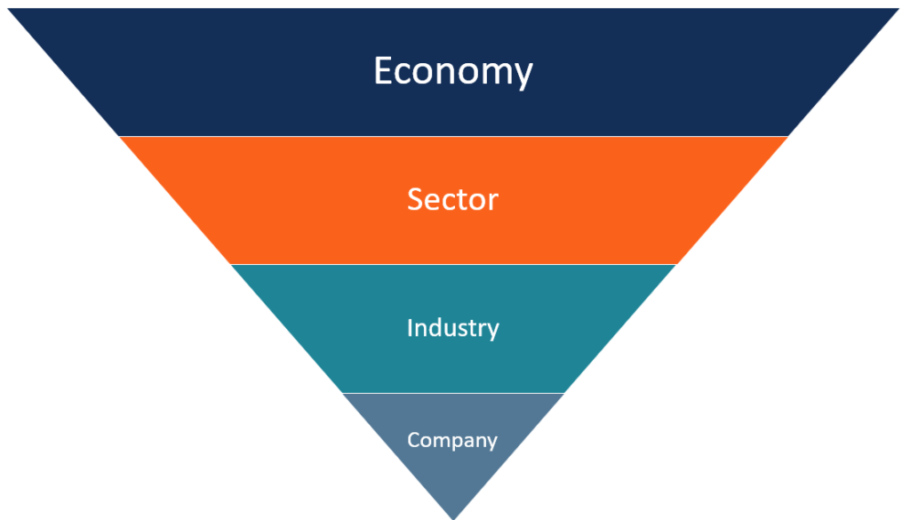
Top-down

Slide 10
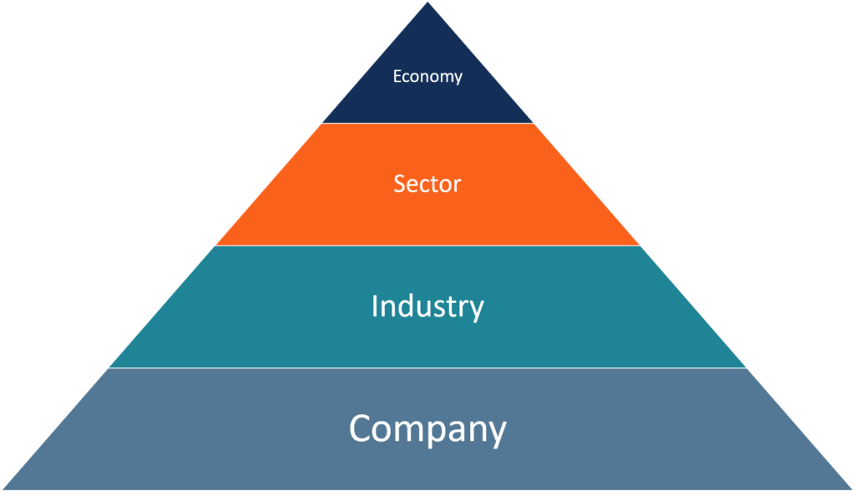
bottom-up approach

Slide 11
fundamental analysis is done in three steps
1. Economic Analysis:-
The first step to this type of analysis includes looking at the macroeconomic situation.
GDP
growth rates
Inflation
interest rates
exchange rates,
productivity
energy prices.

Slide 12
Analyze the state of the world economy
Pick certain asset classes that will outperform others
Pick geographic locations
Narrow to industry analysis

Slide 13
2. Industry Analysis
The SECOND step taken in FUNDAMENTAL analysis is looking at the industry as a whole which includes industry analysis looks at
total sales
price levels
competition and their effects
Foreign competition
any entrances or exits from the industry

Slide 14
3. Company Analysis:-
Last in this process of studying the fundamentals includes looking at the company individually
This includes looking at:
unit sales
prices
new products
earnings and
Any chance of debt or equity occurring

Slide 15
1. Economic analysis
The economy is like the tide and the various industry groups and individual companies are like boats
When the economy expands, most industry groups and companies benefit and grow.
When the economy declines, most sectors and companies usually suffer
Many economists link economic expansion and contraction to the level of interest rates.
Interest rates are seen as a leading indicator for the stock market as well.

Slide 16
GROSS DOMESTIC PRODUCT (GDP)
GDP is one of the core indicators of the current condition of a country's economy.
It measures the monetary value of all final goods and services produced over a specified period (one year) within the boundaries of a country.
Gross Domestic Product (GDP) is the broadest measure of economic activity; however it is only released quarterly

Slide 17
GROSS DOMESTIC PRODUCT (GDP)
The broad components of GDP are:
consumption
Investment
net exports
government purchases
and inventories.

Slide 18
PERSONAL CONSUMPTION
Personal consumption expenditures (PCE) represent roughly 2/3 of GDP. By monitoring retail sales, policy makers are able to make an assessment of the likely growth of PCE for the current and future quarters.

Slide 19
INFLATION
Is a general increase in prices in an economy and consequent fall in the purchasing power of money.
Economists distinguish between two types of inflation.
Demand-pull inflation arises when the economy is trying to spend beyond its capacity to produce.
Cost-push inflation is driven by increases in nominal wages and in the prices of non-wage inputs such as raw materials and energy.

Slide 20
INTEREST RATES
If there is an uncertainty in the market in terms of interest rates
then any developments regarding interest rates will usually have a direct and immediate effect on the currency market.
Generally, when a country raises its interest rates, it’s currency will strengthen in relation to other currencies around the world

Slide 21
INTEREST RATES
WHEN INTEREST RATES ARE HIGHER global assets will be shifted internationally by their owners to gain a higher return on their investments
Interest rate hikes are usually not good news for a nation’s internal stock markets because many investors within the country will withdraw money from a country's stock market to take advantage of the higher / more secure rate of return.

Slide 22
Consumer Price Index (CPI)
CPI IS An index designed to measure the change in price of a fixed market basket of goods and services.
The market basket of goods and services is representative of the purchases of a typical urban consumer.
The index is intended to measure pure price change only; attempts are made to remove changes in price resulting from changes in quality.
Whole price index (WPI) also plays a significant role in the economy.

Slide 23
CONSUMER PRICE INDEX
The rate of change of the CPI is one of the key measures of inflation for the U.S. economy.
Acceleration or deceleration of inflation may signal that a change in monetary policy may be appropriate

Slide 24
Industrial Production/Capacity Utilization INDEX
An index designed to measure changes in the level of output in the industrial sector of the economy.
The index is grouped by both products (consumer goods, business equipment, intermediate goods, and materials) and industry (manufacturing, mining, and utilities

Slide 25
Industrial Production/Capacity Utilization
The industrial sector of the economy represents only about 20% of GDP, because changes in GDP are heavily concentrated in the industrial sector, changes in this index provide
useful information on the current growth of GDP.
information on the overall level of resource utilization in the economy which may in turn provide information on the likely future course of inflation.
Greater utilization will tend to increase inflation

Slide 26
Business Sales and Inventories
Total current-rupee sales and inventories for the manufacturing, wholesale, and retail sectors of the economy
The rate of inventory accumulation plays a key role
in determining the current pace of economic growth
provides useful clues about the future pace of growth as well.
For example,
if inventories are accumulating at a rapid pace, such that inventory sales ratios are rising,
it may portend a slowing of growth in the near future as firms cut production to bring inventories back into line with sales.
Vice versa, if inventories are growing slowly or actually falling, it may signal a future pickup in production.

Slide 27
S&P 500 Stock Index
S&p 500 is one of several indices designed to measure changes in price of a broad array of stocks.
The stock market is one measure of the current value of the nation's stock of capital and is often viewed as a barometer of business and consumer confidence regarding the future.
A high and/or rising stock market may signal robust growth of business investment and consumer spending in the near future
while a low and/or falling stock market may signal sluggish spending. For this reason, the S&P 500 is 1 component of the Index of Leading Indicators.

Slide 28
EMPLOYMENT
The unemployment rate represents the percentage of employable individuals who are actively looking for work within the county.
Unemployment has been a persistent problem in industrial economies during economic slowdowns over the last 200 years and is therefore used as a primary indicator of the health of an economy.
In most cases, statistics are based on the number of people claiming unemployment benefits. A certain level of unemployment is considered to be unavoidable due to
(1) structural changes in an economy
(2) workers who are voluntary switching jobs.
This unavoidable level of unemployment is called the natural level of unemployment.

Slide 29
International TRADE
The trade balance portrays the net difference (over a period of time) between the imports and exports of a nation.
When a nation imports more than it exports, the trade balance shows a deficit.
Although this is for the most part considered unfavorable, a deficit in and of itself is not necessarily a bad thing.

Slide 30
Global economic analysis
Over view:
Growth in the WORLD economy has resumed after the most virulent recession in decades.
Recession caused by world financial meltdown triggered by the subprime loan problem

Slide 31
World economic recovery continued
The recovery is driven by
exceptionally strong demand-supporting policy measures.
public interventions in financial markets
a strong pick-up in demand in the industrial world
a positive contribution from inventory adjustment

Slide 32
Upward and downward risks are broadly balanced
Better economic prospects and stronger business investment driven by better financial conditions reducing concerns about the health of financial institutions which in turn improving financial conditions, and thereby growth, still further.
On the other hand, financial conditions could worsen abruptly, for example, if a large financial institution were to get into difficulty

Slide 33
Fiscal policy.
Its govt. revenue and expenditure policy. Currently all western world fiscal policy is that of stimulating the economy
Policy stimulus measures already decided need to be implemented fully.
However, as the recovery gathers strength, the focus needs to shift from supporting aggregate demand to consolidating budgets.

Slide 34
2. Industry Analysis
Classifying industries
Cyclical industry - performance is positively related to economic activity
Defensive industry - performance is insensitive to economic activity
Growth industry - characterized by rapid growth in sales, independent of the business cycle

Slide 35
Industry Analysis
Industry Life Cycle Theory:
Birth (heavy R&D, large losses - low revenues)
Growth (building market share and economies of scale)
Mature growth (maximum profitability)
Stabilization (increase in unit sales may be achieved by decreasing prices)
Decline (demand shifts lead to declining sales and profitability - losses)

Slide 36
Industry Analysis
Life Cycle of an Industry (Marketing view)
Start-up stage: many new firms; grows rapidly (example: genetic engineering)
Consolidation stage: shakeout period; growth slows (example: video games)
Maturity stage: grows with economy (example: automobile industry)
Decline stage: grows slower than economy (example: railroads)

Slide 37
Industry Analysis
Qualitative Issues
Competitive Structure
Permanence (probability of product obsolescence)
Vulnerability to external shocks (foreign competition)
Regulatory and tax conditions (adverse changes)
Labor conditions (unionization)

Slide 38
Industry Analysis
End use analysis
identify demand for industry’s products
estimates of future demand
identification of substitutes
Ratio analysis
examining data over time
identifying favorable/unfavorable trends
Regression analysis
determining the relationship between variables

Slide 39
3. Company Analysis: Qualitative Issues
Sales Revenue (growth)
Profitability (trend)
Product line (turnover, age)
Output rate of new products
Product innovation strategies
R&D budgets
Pricing Strategy
Patents and technology

Slide 40
3. Company Analysis: Qualitative Issues
Organizational performance
Effective application of company resources
Efficient accomplishment of company goals
Management functions
Planning - setting goals/resources
Organizing - assigning tasks/resources
Leading - motivating achievement
Controlling - monitoring performance

Slide 41
3. Company Analysis: Qualitative Issues
Evaluating Management Quality
Age and experience of management
Strategic planning
Understanding of the global environment
Adaptability to external changes
Marketing strategy
Track record of the competitive position
Sustainable growth
Public image
Finance Strategy - adequate and appropriate
Employee/union relations
Effectiveness of board of directors

Slide 42
3. Company Analysis: Quantitative Issues
Operating efficiency
Productivity
Production function
Importance of Q.A.
Understanding a company’s risks
Financial, operating, and business risks
Financial Ratio Analysis
Past financial ratios
With industry, competitors, and
Regression analysis
Forecast Revenues, Expenses, Net Income
Forecast Assets, Liabilities, External Capital Requirements

Slide 43
An Adage
“Financial statements are like fine perfume;
To be sniffed but not swallowed.”

Slide 44
Company Analysis: Quantitative Issues
Balance Sheet
Snapshot of company’s Assets, Liabilities and Equity.
Income statement
Sales, expenses, and taxes incurred to operate
Earnings per share
Cash flow statement
Sources and Uses of funds
Are financial statements reliable?
G.A.A.P. vs Cleverly Rigged Accounting Ploys

Slide 45
Company Analysis: Quantitative Issues
Financial Ratio Analysis
Liquidity (ability to pay bills)
Debt (financial leverage)
Profitability (cost controls)
Efficiency (asset management)
DuPont Analysis
Top-down analysis of company operations
Objective: increase ROE

Slide 46
Liquidity Ratios
Measure ability to pay maturing obligations
Current ratio
Current assets / current liabilities
Quick ratio
(Current assets less inventories) / current liabilities

Slide 47
Debt Ratios
Measure extent to which firm uses debt to finance asset investment (risk attribute)
Debt-equity ratio
Total long-term debt / total equity
Total debt - total assets ratio
(Current liabilities + long-term debt) / total assets
Times interest earned
EBIT / interest charges
Fixed charge coverage ratio
(EBIT + Lease Exp.) / (Int. Exp. + Lease Exp.)

Slide 48
Profitability Ratios
Measure profits relative to sales
Gross profit margin ( % ) = Gross profit / sales
Operating Profit Margin = Operating profits / sales
Net profit margin = Net profit after taxes / sales
ROA = Net Profit / Total Assets
ROE = Net Profit / Stockholder Equity*
* Excludes preferred stock balances

Slide 49
Efficiency Ratios
Measure effectiveness of asset management
Average collection period (in days)
Average receivables / Sales per day
Inventory turnover (times per year)
Cost of Goods Sold / average inventory
Total asset turnover
Sales / average total assets
Fixed asset turnover
Sales / average net fixed assets

Slide 50
Other Ratios
Earnings per share (EPS): (Net income after taxes – preferred dividends)/ number of shares
Price-earnings (P/E): Price per share/expected EPS
Dividend yield: Indicated annual dividend/price per share
Dividend payout: Dividends per share/EPS
Cash flow per share: (After-tax profits + depreciation and other noncash expenses)/number of shares
Book value per share: Net worth attributable to common shareholders/number of shares

Slide 51
Thx

