Slide 1
Types of Financial Forecasting Methods
Dr. Manish Dadhich

Slide 2
Introduction
Planning for the future is one of the key aspects of organizational management and is critical to the success of all businesses, irrespective of their size.
This technique is called forecasting, and it includes estimating important factors, such as sales volumes, expenses, investment and profit, that could influence outcomes for a business

Slide 3
Techniques
A. Qualitative Techniques
B. Quantitative Techniques

Slide 4
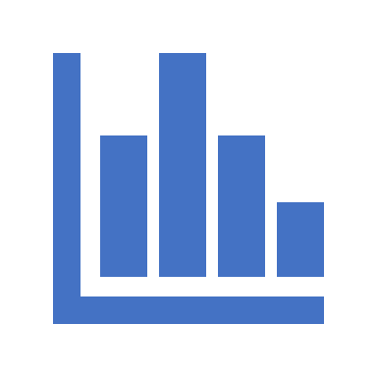
A. Qualitative Techniques
1. Executive Opinions
2. Reference Class Forecasting
3. Delphi Technique
4. Sales Force Polling
5. Consumer Surveys
6. Scenario Writing
7. Focus groups

Slide 5
1. Executive Opinions
In this method, the expert opinions of key personnel of various departments, such as production, sales, purchasing and operations, are gathered to arrive at future predictions.
The management team makes revisions in the resulting forecast, based on their expectations.

Slide 6
2. Reference Class Forecasting
This method involves predicting the outcome of a planned action based on similar scenarios in other times or places.
This is used to defy predictions that are arrived at based only on human judgment.

Slide 7
3. Delphi Technique
A series of questionnaires are prepared and answered by a group of experts, who are kept separate from each other. Once the results of the first questionnaire are compiled, a second questionnaire is prepared based on the results of the first.
This second document is again presented to the experts, who are then asked to reevaluate their responses to the first questionnaire. This process continues until the researchers have a narrow shortlist of opinions.

Slide 8
4. Sales Force Polling:
Some companies believe that salespersons have close contact with the consumers and could provide significant insights regarding customer behavior.
In this method of forecasting, the estimates are derived based on the average of sales force polling.

Slide 9
5. Consumer Surveys
Businesses often conduct market surveys of consumers. The data is collected via telephonic conversations, personal interviews or survey questionnaires, and extensive statistical analysis is conducted to generate forecasts.

Slide 10
6. Scenario Writing:
In this method, the forecaster generates different outcomes based on diverse starting criteria. The management team decides on the most likely outcome from the numerous scenarios presented.

Slide 11
7. Focus groups
It involves engaging about five to ten people from a business firm’s target customers in an open-ended discussion.
Moderator who sees to turn-taking among the participants and also asks questions related to their perception of the brand, products, slogans, design and related concepts.
Provide insightful responses which represent the opinion of a larger market it targets. Focus group discussions may involve incentives like a financial reward or any equivalent measure in terms of free good items.

Slide 12
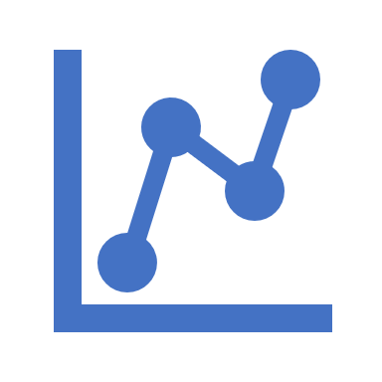
B. Quantitative Techniques
1. Proforma Financial Statements
2. Time-Series Forecasting
3. Correlation forecasting
4. Regression Analysis
5. Graphical methods
6. Moving Average
7. Econometric modeling

Slide 13
1. Proforma Financial Statements:
Proforma statements use sales figures and costs from the previous two to three years after excluding certain one-time costs.
This method is mainly used in mergers and acquisitions, as well as in cases where a new company is forming and statements are needed to request capital from investors.

Slide 14
1. Proforma Financial Statements:
Proforma statements use sales figures and costs from the previous two to three years after excluding certain one-time costs.
This method is mainly used in mergers and acquisitions, as well as in cases where a new company is forming and statements are needed to request capital from investors.

Slide 15
2. Time-Series Forecasting:
Time-series forecasting is a popular quantitative forecasting technique, in which data is gathered over a period of time to identify trends. Time-series methods are one of the simplest methods to deploy and can be quite accurate, particularly over the short term. Some techniques that fall within this method are simple averaging and exponential smoothing.

Slide 16
3. Correlation forecasting
Identifying correlating variables and tracking how they move together or follow one another. Many companies rely on this method because it assesses how different factors affect each other. When analyzing the relationship between two factors, you can determine how growth in one area may affect another.
For example, when demand increases, supply typically decreases, so a forecasted increase in demand for a particular product can cause a business to increase its inventory supply or budget funds to invest in more products.

Slide 17
4. Regression Analysis
This covers a group of methods for forecasting that is dependent on information gathered from other variables (dependent and independent).
Largely, it depends on the ability to use data generating process. There is simple linear regression which involves comparing an independent variable with a dependent variable and there is multiple linear regressions in which two or more independent variables are compared with one dependent variable.
Y=a+bx+e

Slide 18
5. Graphical methods
This involves a statistical method but it is simple and useful for the sales forecast. With this method, periodic sales data for various years can be illustrated graphically with meeting points established by drawing free-hand lines.
Based on the graph, the distance between points and line determines the minimum.

Slide 19
6. Moving Average
Time series method which involves a calculation to examine data points by creating an average series of various subsets from complete data. The formula involves a series of number and fixed subset size.
The forecaster takes the average of the formerly fixed subset and then modifies it by taking out the first number of the series and adding the value that follows in the subset series.
This method is statistical, and it is usually adopted to deal with fluctuations only continuing for a short-term, technical analysis of financial data, evaluation of GDP, among others.

Slide 20
7. Econometric modeling
This is an improvement on regression analysis. It involves the calculation of independent regression under equation, variables and data.
Meanwhile, it is economic theories that are adopted in the statistical method to determine the influence of one economic variable on another.

Slide 21
Conclusion
Forecasting is a tool that helps management to deal with the fluctuating market. With reliable historical data or opinions of the expert, a business firm will be able to predict future trends that can be manipulated to make the market work in their favour.
The various demand forecasting methods available are categorized into quantitative and qualitative.
Meanwhile, it should be noted that there is no strict rule on the use of any forecasting method. If need be, it can be adjusted to the particular need of a business firm.
Two or more forecasting methods can be adopted at a time by a business.

Slide 22
Thank you

