Slide 1
Internet Banking

Slide 2
Why did we choose INTERNET BANKING??
Internet banking is becoming more and more popular among the masses.
To provide more Quality Information on Internet Banking.
Make the concept and procedure more familiar.
To warn against its negative effects.

Slide 3
What is Internet Banking all about??
Internet banking means any user with a personal computer and a browser can get connected to his bank’s website to perform any of the virtual banking functions:
Balance enquiry.
Transfer of funds.
Online payment of bills.
Accrued interest, fees and taxes.
Transaction details of each account.
Accounts, credit card & home loan balances.
Transfer funds to third party accounts you nominate.
Open a deposit right from the terminal you are sitting at.

Slide 4
History
The concept of Internet banking has been simultaneously evolving with the development of the World Wide Web. Programmers working on banking data bases came up with ideas for online banking transactions, sometime during the 1980's.
In 1983, the Nottingham Building Society, commonly abbreviated and referred to as the NBS, launched the first Internet banking service in United Kingdom. This service formed the basis for most of the Internet banking facilities that followed. The facility introduced by Nottingham Building Society is said to have been derived from a system known as Prestel that is deployed by the postal service department of United Kingdom.

Slide 5
History In India
ICICI was the first bank to initiate the Internet Banking Revolution in India as early as 1997 under the brand name Infinity.
ICICI kicked off online banking way back in 1996. But even as a whole, 1996 to 1998 marked the adoption phase, while usage increased only in 1999-due to lower ISP online charges, increased PC Penetration and a Tech Friendly atmosphere.

Slide 6
How to access Internet Banking?
Before you can access your account online, you’ll need to register with your bank for Internet banking.
Your bank will give you a registration number or login ID. You’ll also need a password (IPIN). Your Internet password is different from the PIN you use with your debit card.
Once your bank has approved your registration, you’re able to access your accounts online.

Slide 7
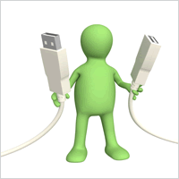
STEP 1:
Make sure your computer is connected to the Internet.

Slide 8
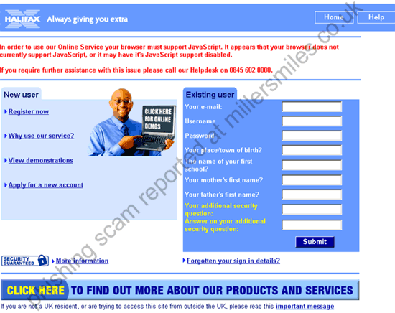
STEP 2:
Go to your bank’s website.
For security reasons, don’t click on a link to your bank sent to you in an email – emails with links to fake websites are a classic ploy of
criminals trying to steal your identity

Slide 9
STEP 3:
Once you’re on your bank’s website you’ll see a button or other icon labelled ‘Log on to Internet banking’ or something similar (the terminology varies from bank to bank)
Click on this icon
It will take you to a login page

Slide 10
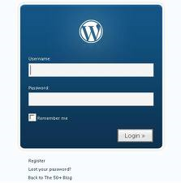
STEP 4:
Login to your Internet account
It generally requires you to enter your registration number or login ID
You will also have to enter your
password – either by typing it in, or
by clicking on letters and numbers
onscreen

Slide 11
STEP 5:
Some banks have a two stage authentication process
an additional security measure to protect customers’ accounts and personal data.
If a two-stage process, you’ll then have to enter another code.
The code may be generated by a security token
the bank gives you when you register for
Internet banking, or it could be contained in an
SMS message the bank sends to your mobile
phone.

Slide 12
STEP 6:
If you’ve entered the correct information at all these stages, you’ll gain access to your accounts and be able to begin your Internet banking

Slide 13
STEP 7:
Once you’ve got online access to your accounts you’ll see the different types of transactions that you can perform. Usually on the left side of the screen there will be a list of functions. Click on a function to open it.
For example, if you want to transfer funds, click on the button or icon labelled ‘Transfers’ or something similar. You’ll need to complete the required data.
Remember – make sure that you have the right
BSB (Bank State Branch ) code and account number for the beneficiary of the transfer, as this is the information that the bank will use to process the transfer.

Slide 14
STEP 8:
Once you’ve finished your Internet banking, be sure to log out from your account.
Most banks also have in place a ‘time-out’ feature, which means that if you’re inactive for
a certain period in your Internet
banking session, you’ll
automatically be logged out.

Slide 15
Merits/Demerits of Internet Banking
Merits:
Convenience: Unlike your corner bank, online banking sites never close; they're available 24 hours a day, seven days a week, and they're only a mouse click away.
Ubiquity: If you're out of state or even out of the country when a money problem arises, you can log on instantly to your online bank and take care of business, 24/7.
Transaction speed: Online bank sites generally execute and confirm transactions at or quicker than ATM processing speeds.

Slide 16
Efficiency: You can access and manage all of your bank accounts, including IRAs, CDs, even securities, from one secure site.
Effectiveness: Many online banking sites now offer sophisticated tools, including account aggregation, stock quotes, rate alerts and portfolio managing programs to help you manage all of your assets more effectively. Most are also compatible with money managing programs such as Quicken and Microsoft Money.

Slide 17
Demerits:
Start-up may take time: In order to register for your bank's online program, you will probably have to provide ID and sign a form at a bank branch. If you and your spouse wish to view and manage your assets together online, one of you may have to sign a durable power of attorney before the bank will display all of your holdings together.
Learning curve: Banking sites can be difficult to navigate at first. Plan to invest some time and/or read the tutorials in order to become comfortable in your virtual lobby.
Bank site changes: Even the largest banks periodically upgrade their online programs, adding new features in unfamiliar places. In some cases, you may have to re-enter account information.
The trust thing: For many people, the biggest hurdle to online banking is learning to trust it. Did my transaction go through? Did I push the transfer button once or twice? Best bet: always print the transaction receipt and keep it with your bank records until it shows up on your personal site and/or your bank statement.

Slide 18
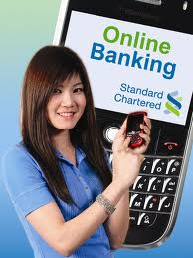
Services provided under internet banking
Online Bill Payment
Personal Home Page
Ticket Booking
Prepaid Mobile Recharge
Market Watch
Investment Services
Online Applications
Personal updates

Slide 19
SECURITY RISK OF INTERNET BANKING
Increasing number of fraudulent bank websites.
Fake emails purporting to be sent from banks.
Use of Trojan Horse programs to capture user IDs and passwords.
Hackers who hack into personal bank accounts and steal money.

Slide 20
Fraudulent Bank Websites
Nowadays a large number of fraudulent websites are coming up which aim to trick persons into disclosing their sensitive personal information.

Slide 21
Fake Emails
This method is also known as Phishing. In the field of computer security, phishing is the criminally fraudulent process of attempting to acquire sensitive information such as usernames, passwords and credit card details by hidden as a trustworthy entity in an electronic communication
Emails are send by Fraudulent bank.
Customer’s verify the personal information.
These Emails Guide customers and make them enter the fraud links.
Thereby Disclosing the customer’s ATM card numbers and their passwords

Slide 22
Hackers
Pharming is a hacker's attack aiming to redirect a website's traffic to another, bogus website.
In recent years both pharming and phishing have been used for online identity theft information. Pharming has become of major concern to businesses hosting ecommerce and online banking websites. Sophisticated measures known as anti-pharming are required to protect against this serious threat. Antivirus software and spyware removal software cannot protect against pharming.

Slide 23
Conclusion
Internet banking is changing the banking industry and is having the major effects on banking relationships.
The net banking, thus, "now is more of a norm rather than an exception in many developed countries" due to the fact that it is the economical way of providing banking services.
Banking is now no longer confined to the traditional brick and mortar branches, where one has to be at the branch in person, to withdraw cash or deposit a cheque or request a statement of accounts.

Slide 24
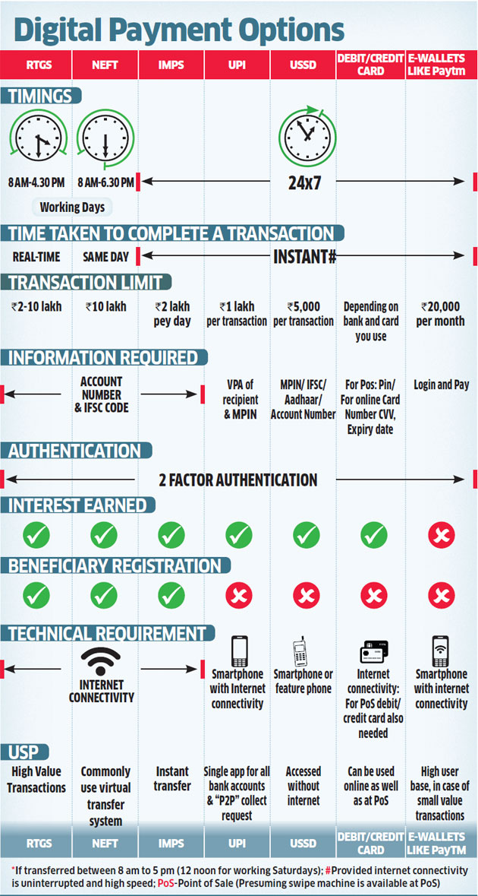
Small Thx
UPI-Unified payment interface USSD- Unstructured supplementary service data SWIFT- Society for Worldwide Inter-bank Financial Telecommunications CVV- Card verification value

Slide 25
thx

