Slide 1
Business: Definition, Nature, and Types
Dr. Manish Dadhich
Ph.D., M.Com, NET;
MBA, NET, SET
Sir Padampat Singhania University, Udaipur

Slide 2
What is Business??
Business is an integral part of modern society.
Organized and systematic activity for earning profit.
Concerned with activities of people working towards a common economic goal.
Modern society cannot exist without business.
Business improves the people's standard of living by providing better quality and a large variety of goods and services at the right time and at the right place

Slide 3
Definition
Business is a regular process of earning a profit by satisfying consumer's needs through the manufacturing of goods, reselling of products, providing services, or carrying out all three together. It is an occupation that requires a particular set of skills and expertise to derive maximum profit.
Business refers to an occupation in which goods and services are produced and sold in return of money. It is carried out on a regular basis with the prime objective of making profit. Mining, manufacturing, trading, transporting, storing, banking, and insurance are examples of business activities.

Slide 4
Following activities cannot be considered as a business:
Preparing food and distributing it in an orphanage;
Voluntary services
Selling of drugs;
A mother teaches her child.

Slide 5
Nature of Business
Business is derived from 'busy-ness,' i.e. keeping oneself occupied with one or the other work, but it is much more than just being busy.
To have a better understanding of what a business is, we must go through the following points:

Slide 6
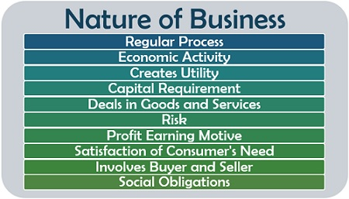

Slide 7
Nature of Business
Regular Process: It is an activity which is performed repeatedly to generate profit.
Economic Activity: The whole sole purpose is maximizing wealth.
Creates Utility: The goods or service must be such that it creates form utility – conversion of products in a consumable form, time utility – making the goods and services available when needed; and place utility – availability of goods or services wherever required, for the consumers.
Capital Requirement: Any venture requires funds depending on its size and type.
Deals in Goods and Services: It is related to manufacturing and offering goods for sale or catering services.

Slide 8
6. Risk: All businesses have a risk factor or uncertainties of failure and loss. (more risk more profit)
7. Profit Earning Motive: The initial motive of a businessman is making a profit out of his venture.
8. Satisfaction of Consumer's Need: It is concerned with the fulfilment of the customer's demands and needs.
9. Involves Buyer and Seller: There are majorly two parties involved, the customer and the merchandise.
10. Social Obligations: It has some social responsibilities, like creating job opportunities, dealing with licensed products, etc.

Slide 9
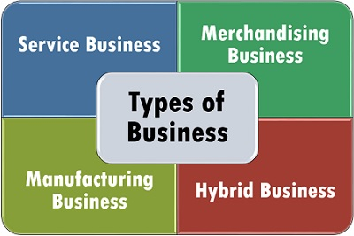
Types of Business
A business entity is an organization that uses economic resources or inputs to provide goods or services to customers in exchange for money or other goods and services.

Slide 10
1. Service Business
A service type of business provides intangible products (products with no physical form). Service type firms offer professional skills, expertise, advice, and other similar products.
Examples of service businesses are salons, schools, banks, accounting firms, and law firms.

Slide 11
2. Merchandising Business
This type of business buys products at wholesale price and sells the same at retail price.
They are known as "buy and sell" businesses. They make profit by selling the products at prices higher than their purchase costs.
A merchandising business sells a product without changing its form. Examples are grocery stores, convenience stores, distributors, and other resellers.

Slide 12
3. Manufacturing Business
Unlike a merchandising business, a manufacturing business buys products intending to use them as materials in making a new product. Thus, there is a transformation of the products purchased.
A manufacturing business combines raw materials, labor, and factory overhead in its production process. The manufactured goods will then be sold to customers

Slide 13
4. Hybrid Business
Hybrid businesses are companies that may be classified in more than one type of business. A restaurant, for example, combines ingredients in making a fine meal (manufacturing), sells a cold bottle of wine (merchandising), and fills customer orders (service).
Nonetheless, these companies may be classified according to their major business interest. In that case, restaurants are more of the service type – they provide dining services.

Slide 14
Types of Business Organization
Sole Proprietorship
A sole proprietorship is a business owned by only one person. It is easy to set-up and is the least costly among all forms of ownership. The owner faces unlimited liability; meaning, the business's creditors may go after the owner's personal assets if the business cannot pay them. Small business entities usually adopt the sole proprietorship firm.

Slide 15
2. Partnership
A partnership is a business owned by two or more persons who contribute resources to the entity.
The partners divide the profits of the business among themselves. In general partnerships, all partners have unlimited liability. In limited partnerships, creditors cannot go after the personal assets of the limited partners.

Slide 16
3. Corporation
A corporation is a business organization with a separate legal personality from its owners. Ownership in a stock corporation is represented by shares of stock.
The owners (stockholders) enjoy limited liability but have limited involvement in the company's operations. The board of directors, an elected group from the stockholders, controls the corporation's activities. In addition to those basic forms of business ownership, these are some other types of organizations that are common today: one person company.

Slide 17
4. Limited Liability Company
Limited liability companies (LLCs) in the USA, are hybrid forms of business that have characteristics of both a corporation and a partnership. An LLC is not incorporated; hence, it is not considered a corporation.
Nonetheless, the owners enjoy limited liability like in a corporation. An LLC may elect to be taxed as a sole proprietorship, a partnership, or a corporation.

Slide 18
5. Cooperative
A cooperative is a business organization owned by individuals and operated for their mutual benefit.
The persons making up the group are called members. Cooperatives may be incorporated or unincorporated. Some examples of cooperatives are: water and electricity (utility) cooperatives, cooperative banking, credit unions, and housing cooperatives.

Slide 19
Scope of Business Activities
Let's look around and find out the various types of business activities that usually take place in an economy. Some of these are:
Extraction of oil, natural gas or minerals.
Manufacturing of commodities.
Buying of goods from one place/country and selling it at different place/country;
Construction of buildings, roads, bridges etc.
Providing services like ticketing, warehousing, transportation, banking, insurance etc.
When we analyze the above business activities, we find that most business activities are concerned with the production and/or processing of goods and services or distribution of goods and services

Slide 20
Thank You

