Slide 1
Financial analysis
Dr. Manish dadhich

Slide 2
Financial analysis
Financial analysis is the process of evaluating businesses, projects, budgets, and other finance-related transactions to determine their performance and suitability. Typically, financial analysis is used to analyze whether an entity is stable, solvent, liquid, or profitable enough to warrant a monetary investment.

Slide 3
Types of Financial Analysis
Financial analysis means the analysis of the financial statement to reach up to the productive conclusion, which will help the investors and other stakeholders to maintain their relationship with the company and there are various types that experts and analysts use to do a post-mortem of financial statements. Below is the list of 10 types of financial analysis –

Slide 4
Types of Financial Analysis
Horizontal Analysis
Vertical Analysis
Trend Analysis
Liquidity Analysis
Solvency Analysis
Profitability Analysis
Scenario & Sensitivity Analysis
Variance Analysis
Valuation Analysis
FP&A Analysis

Slide 5
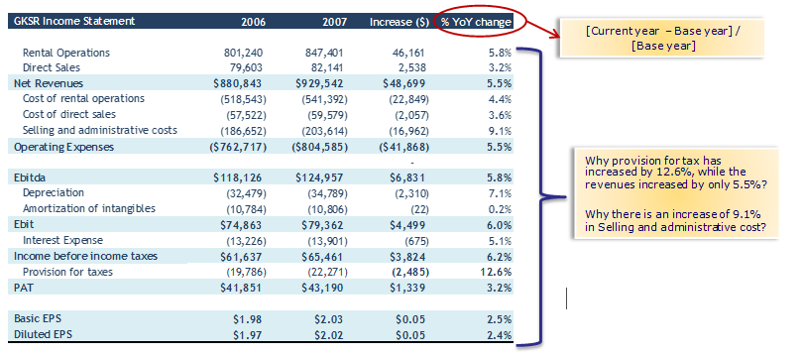
1. Horizontal Analysis
The horizontal analysis measures the line items of financial statements with the base year. That means, it compares the figures for a given period with the other period.

Slide 6
2. Vertical Analysis
The vertical analysis measures the line item of the income statement or balance sheet by taking any line item of financial statement as a base and will disclose the same in percentage form.
For example, in Income Statement, to disclose all the line items in percentage form by taking base as Net sales. Likewise, in the Balance sheet on the asset side, to disclose all the line items in the percentage form of total assets.

Slide 7
2. Vertical Analysis

Slide 8
3. Trend analysis
Trend analysis means identifying patterns from multiple time period and plotting those in a graphical format such that actionable information could be derived.

Slide 9
4. Liquidity Analysis
The short-term analysis focus on routine expenses. It analyses the short-term capability of the company with respect to day-to-day payments of trade creditors, short-term borrowings, statutory payments, salaries etc. Its main intent is to verify the appropriate liquidity being maintained thoroughly for the given period and all the liabilities are being met without any default.
The short-term analysis is carried out using the technique of ratio analysis, which uses various ratios like liquidity ratio, current ratio, quick ratio, etc

Slide 10
5. Solvency Analysis
The long-term analysis is also termed as Solvency analysis. Focus under this analysis is to ensure the proper solvency of the company in the near future and to check whether the company is able to pay all the long-term liabilities and obligations. It gives stakeholders confidence about the survival of the entity with proper financial health.
Solvency ratios like Debt to Equity ratio, Equity Ratio, Debt ratio etc give a correct picture of the financial solvency and burden on the firm in the form of external debts.

Slide 11
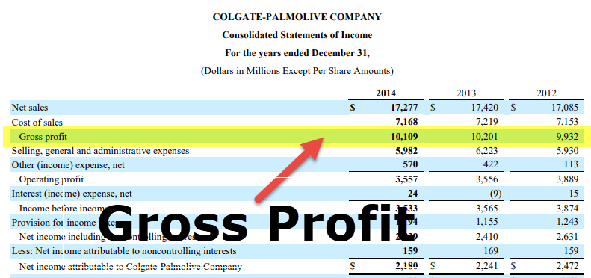
6. Profitability Analysis
In order to verify the viability of the decision, they carry out profitability analysis, which will check the rate of return in a given period, This will help the investor in obtaining assurance of safekeeping of funds.

Slide 12
7. Scenario & Sensitivity Analysis
In business, day in and day out various changes keep on coming. In addition, based on the economic outlook, various kinds of changes in tax structures, banking rates, duties, etc. Each of this determinants highly affects the financials, hence it is utmost important that treasury department does such sensitivity analysis with respect to each factors.
You can use the following to do sensitivity analysis –
Sensitivity Analysis
Data Table using Excel
Two-Variable Data Table using Excel
One Variable Data Table using Excel

Slide 13
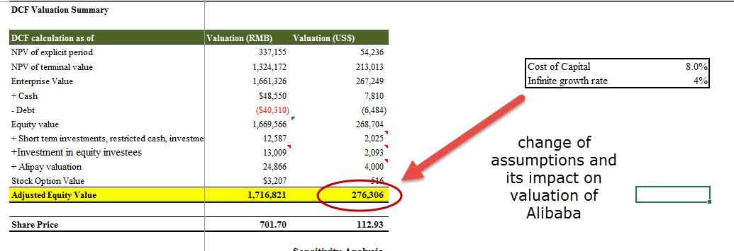
7. Scenario & Sensitivity Analysis

Slide 14
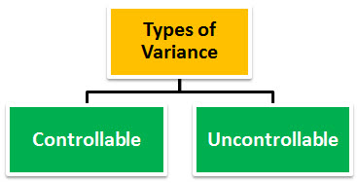
8. Variance Analysis
Business runs on estimates and budgets, after the completion of transactions, it is utmost important to check the variance in between budget and estimates with the actuals one. Such variance analysis will help in checking any loopholes in the process and hence it will help an entity to take corrective actions for avoidance of the same in the future.

Slide 15
9. Valuation
Valuation analysis means deriving the company’s fair valuation. You may use one of the following valuation financial analysis tools
Dividend Discount Model
DCF Formula
Relative Valuation Multiples
Transaction Multiples

Slide 16
9. Valuation

Slide 17
10. FP&A Analysis
Every company will be having its own financial planning and analysis (FP&A) department whose main work is to analyze the internal organization’s various data points and to construct the Management Information System (MIS), which will be reported to top management. Such MIS circulated by FP&A department is of the highest importance for the company as there will be, both published as well as unpublished information. Such analysis helps top management to adopt strategies.

Slide 18
Conclusion
Financial analysis is nowadays considered as the main ingredient in business activity, without this, to run business will turn out to be futile.
Hence for every organization, to do financial analysis is not only necessary but to handle the same diligently and all the findings of the analysis should get duly implemented.

