Slide 1
Core Banking & Banks
Dr. Manish dadhich

Slide 2
Core Banking System
Gartner defines a core banking system as a back-end system that processes daily banking transactions, and posts updates to accounts and other financial records.
Nowadays, banks are using core banking applications to support their operations.
Advanced technology helps to connect branch computers to a single computer at data centre and have all transactions of all branches recorded live at one place. This concept is “CORE BANKING”.

Slide 3
CORE stands for "centralized online real-time exchange”
This basically means that all banks branches access applications from centralized data centres.
This means that the deposits made are reflected immediately on the bank's servers and the customer can withdraw the deposited money from any of the bank's branches throughout the world.
These applications now also have the capability to address the needs of corporate customers, providing a comprehensive banking solution.

Slide 4
Advantages of core banking
1. Consolidation of MIS / statements / reporting at one place reducing duplication of tasks at branches and it is of real time.
2. Supervision of branches on risk perceptions possible as ongoing process.
3. Frequent audits and timely control measures can be initiated.
4. Quick informal decisions on real time MIS.
5. Faster and practically real time reconciliation of accounts.
6. Centralized marking and movement monitoring of NPA accounts.

Slide 5
7. Centralized follow-up and co-ordination of overdue and NPA accounts.
8. For statutory reporting and compliance no need to wait for branch compliance.
9. Quick look of short term assets and liabilities possible.
10. Product-wise, customer-wise, customer profile based analysis and decision making possible.
11. Analysis of data on any aspect of banking business and control issues gives scope for keeping the bank professionally healthy.

Slide 6
12. Clearing function is centralized reducing man power requirement at each branch for the purpose.
13. Audit on operational aspects of the accounts can be done at single location as entire data is available at one place.
14. User access to the computer system in the bank can be restricted to his/her needs and authority only that achieves safety.
15. Printing of several matters such as follow-up notices, statement of accounts etc. can be done centrally on“line printer” that reduces the printing time, printer and manpower need at each branch. Such printer can be activated by any branch on WAN command.
16. Account opening and scanning of signatures can be done at central location.
17. By installing mailing solution on the intra net of the bank, written communication in the form of letters, between H. O. and branches and vice versa, can be eliminated.

Slide 7
Advantages to Customers
1. Customer can operate his account from any of the branch of the bank.
2. More service channels can be made available to the customer.
3. Customer gets immediate credit if the transaction is between the branches of the bank.
4. Even extension counters can provide all services to the Customer.
5. Customer gets full attention and service satisfaction at the branches as the branches are freed from all back office functions, clearing functions and almost all accounting functions.
6. Customer can get SMS alerts on his mobile or e-mail alerts through net for transaction taking place in his account. This gives him comfort and security.

Slide 8
Advantages to I. T. Department
1. I. T. Department becomes the focused entity and back-bone of the operations of the bank.
2. Central data management and application reduces logistical problems and reaction time for system changes and/or trouble shooting.
3. Parameter settings, interest application and such other works being done at one place avoid chances of otherwise repetitive mistakes at different branches and then load on I. T. Dept. for rectification work.

Slide 9
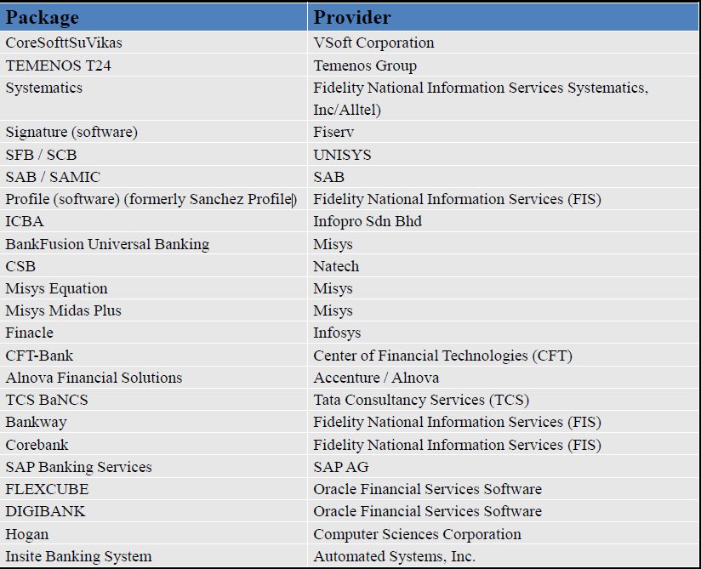
Core Banking Software Provider

Slide 10
Electronic Clearance and Settlement System
It permits both quick and efficient settlement by removing the need for paperwork, and the simultaneous delivery of securities with the payment of a corresponding cash sum in the agreed upon currency.
Block chain Technology
“A Block chain is a digital, immutable, distributed ledger that chronologically records transactions in near real time. The prerequisite for each subsequent transaction to be added to the ledger is the respective consensus of the network participants (called nodes), thereby creating a continuous mechanism of control regarding manipulation, errors, and data quality"F:\Youtube\blockchain.mp4

Slide 11
Work Culture in Banking
Work culture where family concept is practiced among the employees.
Receptivity to new ideas
Opportunities for experimentation
Facilities which supports growth
Record cordial Industrial Relations
Training System
Incentives for Self Development
Employee Suggestion Scheme
Staff Meeting
Study Circle
Brainstorming Sessions

Slide 12
Thx

