Slide 1
Cash Book
Dr. Manish Dadhich
Ph.D, M.Com, NET,
MBA, NET, SET

Slide 2
Cash Book
A cash book is a book of primary entry. All Cash transactions are recorded in the “Cash Book”.
It also serves the purpose of a ledger account and therefore, the cash account and bank acccount are not maintained in the general ledger. Balances in the cash book are taken directly to the trial balance.

Slide 3
FEATURES OF CASH BOOK
To keep record of only cash transactions
All receipts are recorded in debit side
All payments are recorded in credit side
Chronological (date wise) transaction recording of all transactions.
Performs function of both journal and ledger.

Slide 4
Objects or Need of cash book
To find out the total cash receipts and cash payments during a given period.
To ascertain the balance of cash in hand and at bank at any time without actually counting cash and examining Bank passbook
To verify the correctness of cash in hand and bank.

Slide 5
Types of cash book
Simple cash book.
Double column cash book.
Triple Column cash book.
Petty Cash book

Slide 6
Simple cash book
prepared like cash account in ledger.
All the cash receipts are entered in amount column on debit side and all cash payments are appeared on credit side of the amount column.
Cash book is closed and balanced at the end of the month.

Slide 7
Simple Cash Book 2012 Jan 1 Purchased goods for cash Rs. 10000 Jan 6 Sold goods for cash Rs. 25000 Jan 8 Paid rent Rs. 1000 Simple cash book
Date | Receipts | L.F | Amount | Date | Payments | L.F | Amount
2012 Jan 6 Feb 1 | To Sales To Balance b/d |  | 25000 25000 14000 | 2012 Jan 1 Jan 8 Jan 31 | By Purchases By Rent By Balance c/d |  | 10000 1000 14000 25000

Slide 8
Double column cash book
A cashbook with cash and discount column is called double column cashbook.
Two accounts, cash and discount are combined in this book.

Slide 9
Double column cash Book 2012 Jan 1 Paid rent Rs. 1300 Jan 5 Paid to Ram & Co. Rs.3950 Discount Received Rs. 50 Jan 6 Received from Gupta & Co. Rs. 9900 Discount allowed Rs. 100 Double column cash Book
Date | Receipts | L.F | Discount | Amt. | Date | Payments | LF | Discount | Amt.
2012 Jan 6 Feb 1 | To Gupta To Bal b/d |  | 100 100 | 9900 9900 4650 | 2012 Jan 1 Jan 5 Jan 31 | By Rent By Ram By Bal c/d |  | 50 50 | 1300 3950 4650 9900

Slide 10
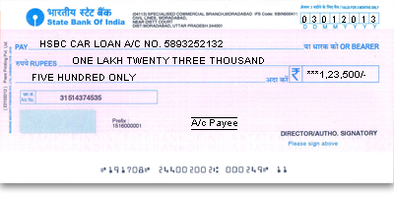
Triple Column cash book
A cash book with discount and bank column is triple column cashbook. Three accounts are combined.
In business firm most of the payments are received and paid by cheque. Transactions are preformed through bank.

Slide 11
Triple Column Cash book
Date | Receipts | L.F | Discount | Cash | Bank | Date | Payments | L.F | Discount | Cash | Bank

Slide 12
Petty Cash Book
Used to record small amount of expenses.
Like stationary, cleaning charges and postage.

Slide 13
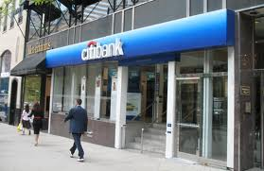
Contra Entry
Where for a single transaction entries are made on both the sides of cash book.

Slide 14
Practical Problems

