Slide 1
CORPORATE SOCIAL RESPONSIBILITY
Dr. Manish Dadhich

Slide 2
CSR is a process by which an organization thinks about and evolves its relationships with stakeholders for the common good and demonstrates its commitment in this regard by adoption of appropriate business processes and strategies. Thus, CSR is no charity or mere donations.
CSR is a way of conducting business, by which corporate entities visibly contribute to the social good. Socially responsible companies use CSR to integrate economic, environmental and social objectives with the company’s operations and growth.

Slide 3
“Corporate Social Responsibility” (CSR) Means and include but not limited to :-
Projects or programs relating to activities specified in the schedule VII of the Act; or
Projects or Programs relating to activities undertaken by BODs of the company in pursuance of the recommendations of the CSR committee of the Board as per declared CSR Policy of the company enumerated in schedule VII of the Act.
“CSR Policy” relates to the activities to be undertaken by the company as specified in schedule VII of the act and the expenditure thereon, excluding activities undertaken in pursuance of normal course of business of a company

Slide 4
Basic Constituents of CSR
Contribute towards a sustainable economic developme
Make desirable social
Improveme nt of social environme
Towards Business & Society
changes
nt
nt

Slide 5
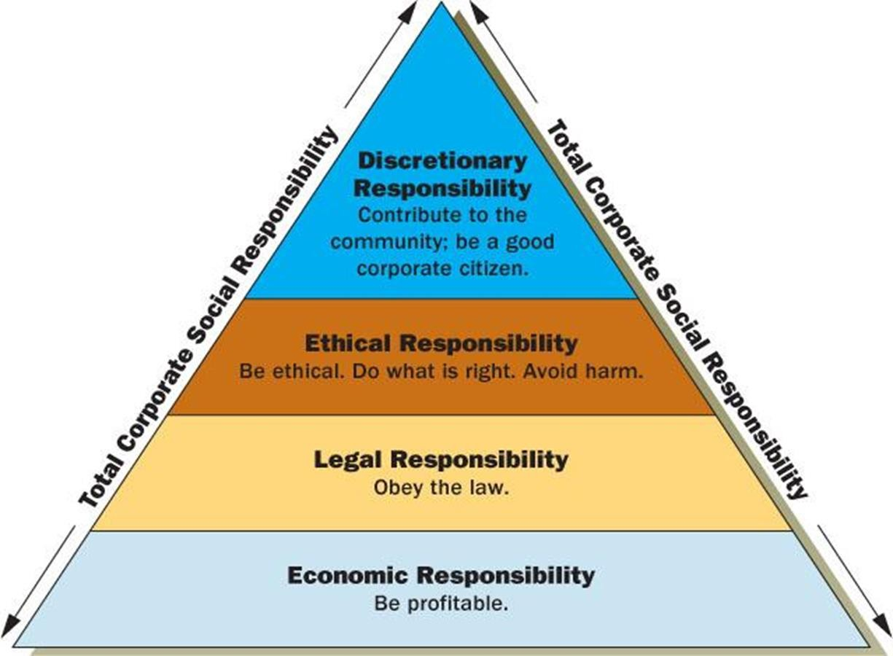

Slide 6
CSR Principles & Strategies.
Respect for human rights.
Respect for the differences of views.
Diversity & non-discrimination should be the guiding principle.
Make some social contribution.
Enter into e dialogue Self-realization & creativity.
Fair dealings & collaboration.
Feedback from the community.
Positive value- added
Long term economic & social development.

Slide 7
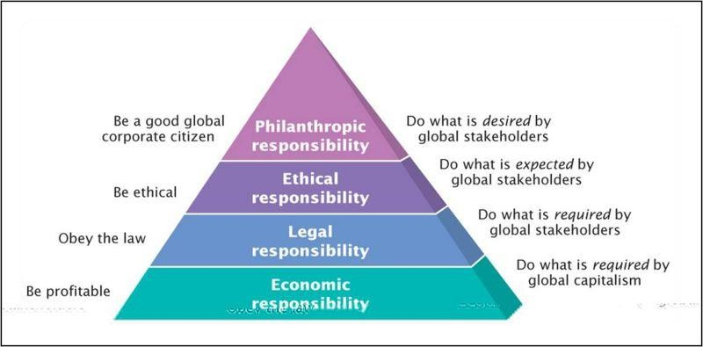
Carroll Model(1991)

Slide 8
Philanthropic requirements: Donation, gifts, helping the poor. It ensure goodwill & social welfare.
Ethical responsibility: Follow moral & ethical
values to deal with all the stakeholders.
Economic responsibility: Maximize the shareholders value by paying good return.
Legal responsibility: Abiding the laws of the land.
▪
▪

Slide 9
Best Practices of CSR
To set a feasible, Viable & measureable goal.
Build a long lasting relationship with the community.
Retain the community core values.
The impact of the CSR needs to be assessed.
Reporting the impact.
Create community awareness.

Slide 10
Need for Corporate Social Responsibility
To reduce the social cost.
To enhance the performance of employees.
It a type of investment, It leads to industrial peace.
It improves the public image, Can generate more profit.
To provide moral justification, It satisfies the stakeholders.
Helps to avoid government regulations & control.
Enhance the health by non polluting measures.

Slide 11
Arguments for the CSR
Corporate should have some moral & social obligations to undertake for the welfare of the society.
Proper use of resources, capability & competence.
The expenditure on CSR is a sort of investment.
Company can avoid many legal complications.
It create a better impression.
Corporate should return a part of wealth.

Slide 12
Arguments against the CSR
Fundamental principles of business gets violated.
It vey expensive for business houses.
CSR projects will not be successful.
There are not the special areas of any business.
CSR is to induce them to steal away the shareholders money.

Slide 13
Indian Perspective.
The Sachar committee was appointed in 1978 to look into corporate social responsibility issues concerning Indian companies
The company must behave & function as a responsible member of
society.
Committee suggests openness in corporate affairs & behaviour.
Some business houses have established social institutions like Schools,
colleges, charitable hospitals etc.
Corporate sectors have not made significant contributions. (Polluting
Environment).

Slide 14
Indian Perspective.
PM’s Ten Point Social Charter 2007
MCA and CSR
Voluntary Guidelines on CSR, 2009
Released in Dec 2009, in presence of the president of India
A statement of Intent by the national government
Intended to be replaced by a more comprehensive guideline.
National Voluntary Guidelines on Social, Environmental and Economic Responsibilities of Business 2011
Planning Commission and Task Force on Business Regulation.

Slide 15
CSR COMMITTEE :-
Composition As per act :-
Compromising of 3 or more directors with at least 1 Independent Director
Composition should be disclosed in the annual board of directors report
Company –wise composition rules :-
Unlisted public or private company u/s 135(1), not required to appoint Independent Director pursuant to sec.149(4) :- Composition committee without independent director
Private company having 2 directors only :- Compose committee with such 2 directors
In case of foreign company:- Committee shall comprise of 2 persons of which
1.) One person shall be specified u/s 380(1)(d) of this act; 2.) Another person shall be nominated by foreign company.

Slide 16
CSR POLICY :-
CSR Policy of the company shall include :-
Projects and programs that are to be undertaken;
A list of CSR projects/ programs which a company plans to undertake, which may also focus on integrating business models with social and environmental priorities and processes in order to create shared value, specified modalities of execution in the execution of areas or sectors chosen and implementation schedules;
CSR Policy would specify that the corpus would include the following:
2% of the average net profits.

Slide 17
LIST OF CSR ACTIVITIES :-
Eradicating extreme hunger and poverty;
Promotion of education;
Promotion of gender equality and empowering women;
Reducing child morality and improving maternal health;
Ensuring environmental sustainability;
Employment enhancing vocational skills;
Social business projects;
Contribution to the Prime Minister's National Relief Fund or any other fund setup by the Central Government or the State Governments for socio-economic development and relief and funds for the welfare of the Scheduled Castes, the Scheduled Tribes, other backward classes, minorities and women ;
Such other matters as may be prescribed. (Corporate Social Responsibility) Companies act, 2013

Slide 18
CSR Activities:
Only such CSR activities will be taken into consideration as are undertaken within India.
Only activities which are not exclusively for the benefit of employees of the company or their family members shall be considered as CSR activity.
The Company to give preference to local area and areas around where it operates, for spending the amount earmarked for CSR activities.
Contribution of any amount directly or indirectly to any political
party u/s 182 of the act, shall not be considered as CSR activity.

