Slide 1
Role of Commercial Banks in India

Slide 2
Role of Commercial Banks in India
Trade Development: The commercial banks provide capital, technical assistance and other facilities to businessmen according to their need, which leads to development in trade.
Supports to Agriculture Development
Supports to Industrial Development
Capital Formation (Capital formation means increase in number of production units, technology, plant and machinery)

Slide 3
Role of Commercial Banks in India
Development of Foreign Trade: Letter of credit is issued by the importer’s bank to the exporters to ensure the payment. The banks also arrange foreign exchange.
Transfer of Money
Supports to more Production (Agriculture & Industry)
Development of Transport (banks financed the transport sector)

Slide 4
Role of Commercial Banks in India
Accelerating the Rate of Capital Formation: They encourage the habit of savings among people and mobilise idle resources for production purpose.
Provision of Finance and Credit: Banks are instruments for developing internal as well as external trade.
Monetisation of Economy: Banks are opening branches in rural areas can promote the process of the monetisation in the economy.
Innovations: Innovations are an essential prerequisite for economic development. These innovations are mostly financed by bank credit in the developed countries.

Slide 5
Role of Commercial Banks in India
Implementation of Monetary Policy
Encouragement to Right Type of Industries
Regional Development
Promote Industrial Development
Fulfillment of Socio-economic Objectives

Slide 6
Nationalization of Commercial Banks in India, Functions of the Commercial Banks

Slide 7
Nationalization of Banks
Nationalization: The act of taking an industry or assets into the public ownership of a national government or state.
Nationalization took place in two phases, with a first round in 1969 covering 14 banks followed by another in 1980 covering six banks.

Slide 8
Reasons for Nationalization
Private commercial banks were not fulfilling the social and developmental goals of banking
The developmental goals of financial intermediation were not being achieved other than for some favored large industries and established business houses.
To ensure that credit allocation occur in accordance with plan priorities.
Reduce the hold of moneylenders and make more funds available for agricultural development. Nationalization of bank was to actively involve in poverty alleviation and employment generation programs.

Slide 9
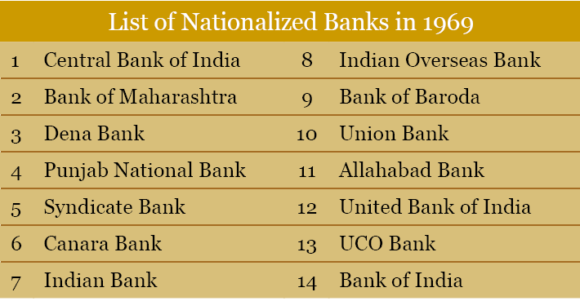

Slide 10
Structure of Indian Commercial Banks
Commercial Banks
Indian Banks
SBI & its Associate Banks
Private Sector Banks
Foreign Banks
Public Sector Banks
Nationalised Banks
Regional Rural Banks
Old Private Banks
New Private Banks

Slide 11
Commercial Banks
A commercial bank is owned by stockholders and operated for profit.
Its primary functions are to receive, transfer, and lend money to individuals, businesses, and governments.
Indian banks consist mostly of Scheduled Commercial Banks (SCBs), which includes both Public Sector Banks, and the Private Sector Banks. In Public Sector Banks, the government must retain a 51% stake.
Contd..

Slide 12
Commercial Banks
Scheduled Commercial Banks in India are categorized into five different groups according to their ownership and / or nature of operation.
These bank groups are
State Bank of India and its Associates
Nationalized Banks
Private Sector Banks
Foreign Banks and
Regional Rural Banks
In the bank group-wise classification, IDBI Bank Ltd. has been included in Nationalised Banks.

Slide 13
The Role of Commercial Banks in Economic Development
Accelerating the Rate of Capital Formation
Provision of Finance and Credit
Monetisation of Economy (support to rural areas)
Innovations
Implementation of Monetary Policy
Encouragement to Right Type of Industries
Development of Agriculture
Regional Development
Fulfillment of socio-economic objectives

Slide 14
Functions
Accepting deposits
Advancing Loans
Discounting Bills of exchange
Agency services and
General services

Slide 15
Accepting Deposits
Demand or Current Account Deposits
A depositor can withdraw it in part or in full at any time he/she likes without notice
It carries no interest
Cheque facility is available
Fixed Deposits or Time Deposits
Fixed deposits for 15days to few years
Withdrawn at expiry of term
High rate of interest
Risk less investment

Slide 16
Accepting Deposits
Saving Bank Deposits
Small saving deposits
less rate of interest
money can be withdrawn through cheques/ATM/by demanding

Slide 17
Advancing Loans
This is the most important means of earnings for the banks.
Giving loans to businessmen.
But it keeps a fine balance between deposits and loans.
Banks profitability depends on this as well

Slide 18
Two ways of advancing loans
By allowing an over draft facility cheques are honoured even if deposits is less facility for businessmen only interest on overdraft amount.
Loans by creating a deposit
Banks give loans to people by charging interest
Bank asks for security
Simply opens an account in name of needy person and issues a cheque book to transact
Loans granted mostly for business

Slide 19
Discounting Bills of Exchange or Hundies
If a seller sells some goods to a buyer who does not pay in cash. But the seller draws a bill of exchange which is signed by buyer.
There is maturity or payment period, say one month.
Now the seller can give this hundy to a bank which will give him/her cash against it.
Bank charges interest on it till one month.

Slide 20
Agency Services
Collection of bills and cheques.
Collection of dividends, interest, and premium.
Purchase and sale of shares and debentures.
Payment of insurance premium.
Acts as trustee when nominated.

Slide 21
General services
Traveller’s cheques, bank draft
Safe vaults for valuables
Supplying trade information
Economic surveys
Projects report preparation

