Slide 1
Breach and Remedies for Breach of Contract Section 73-75
Dr. Manish Dadhich
Asst. Prof.

Slide 2
Breach of Contract
“A Breach of Contract (BoC) occurs if any party refuses or fails to perform his part of the contract or by his act makes it impossible to perform his obligation under the contract.”
A BoC may arise in two ways:
1. Anticipatory Breach, and
2. Actual Breach.

Slide 3
“1. Anticipatory Breach”
It occurs when the party declares his intention of not performing the contract before the performance is due.
Modes of declaring an intention not performing the contract:
(a) When a party to contract has refused to perform his promise.
(b) When a party to contract has disabled himself from performing his promise.
Eg. A, a singer enter into a contract with B to sing at his theatre for 1 month and B paid for that. A willful absent in the theatre, it is anti. Breach.

Slide 4
“2. Actual Breach”
(a) On due date of performance: If any party refuses or fails to perform in his part at the time fixed.
(b) During the course of performance: If any of the party perform a part of the contract and then refuses or fails to perform the remaining part of the contract.
Eg. A agrees to deliver 10 kg of Rice to B on 1st Jan, A fails to deliver the rice to B. This is actual breach.

Slide 5
“Remedies for BoC”
Remedy is the course of action available to the aggrieved party, i.e., the party not at the default, for the enforcement of a right under a contract.

Slide 6
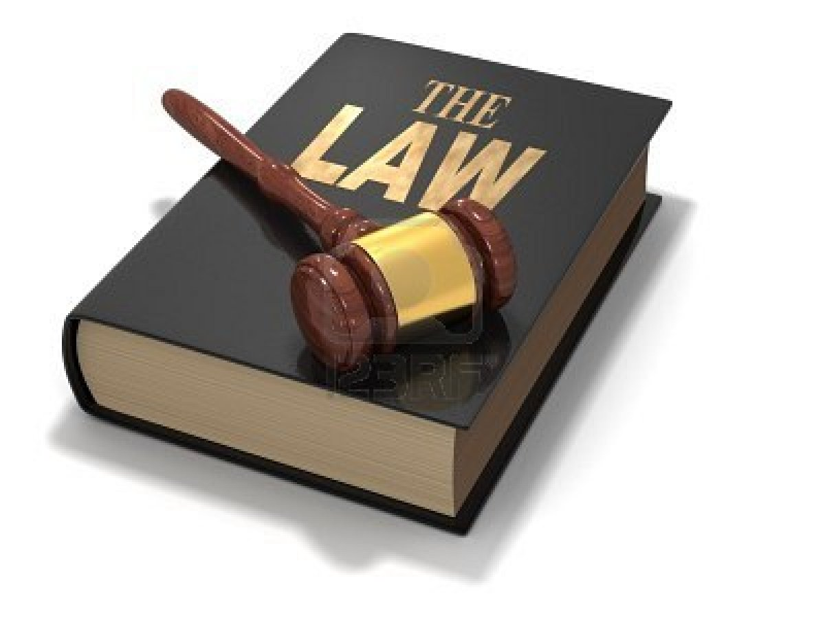
CONTENTS
TYPES OF REMEDIES
SUIT FOR RESCISSION
SUIT FOR DAMAGES
SUIT UPON QUANTUM MERUIT
SUIT FOR SPECIFIC PERFORMANCE
SUIT FOR AN INJUNCTION

Slide 7
In case of breach of contract, the aggrieved or injured part has one of the following remedies
SUIT FOR RESCISSION
SUIT FOR DAMAGES
SUIT FOR QUANTUM MERUIT
SUIT FOR SPECIFIC PERFORMANCE
SUIT FOR AN INJUNCTION

Slide 8
SUIT FOR RESCISSION
Rescission-cancellation of contract.
In such cases, if one party has broken his contractual relations, the other party may treat the breach as discharge and refuse to perform his part of performance.
Thus in case of rescission of contract, the aggrieved or injured party is discharged from all his obligations of the contract.
The parties cannot be restored to their original positions due to changed circumstances.
The party(s) has acquired rights in good faith and value during subsistence of contract.
But if a person rightfully rescinded, he is entitled to compensation for any damage which he has sustained through non fulfilment of the contract by the other party.

Slide 9
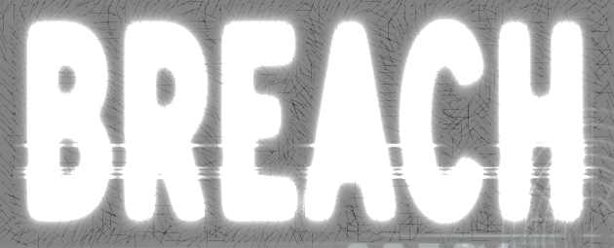
EXAMPLES
Eg.
'A' contracts to supply 10kg of tea leaves for Rs. 8,000 to 'B' on 15 June. If 'A' does not supply the tea leaves on the appointed day, 'B' need not pay the price. 'B' may treat the contract as rescinded and may sit quietly at home. 'B' may also file a ‘suit for rescission’ and claim damages.
A promises B to supply 10 Bags of cement on a certain day. B agrees to pay the price after the receipt of the goods. A does not supply the goods. B is discharged from liability to pay the price

Slide 10
2. SUIT FOR DAMAGES
Damages are a monetary compensation allowed to the injured party for the loss or injury suffered by him as a result of the breach of contract.
The fundamental principle underlying damages is not punishment but to compensate the aggrieved party for the loss suffered by him in the original position as he would have been.

Slide 11
TYPES OF DAMAGES
There are 4 types of damages:
ORDINARY
SPECIAL
EXEMPLARY
NOMINAL DAMAGES.

Slide 12
RULES REGARDING DAMAGES
A- Ordinary or General Damages:
The damages must naturally arise in the usual course of things from such breach i.e. the damages must be the proximate or direct consequence of the breach of contract.
B- Special Damages:
S. D. are those resulting from a breach of contract under some special or usual circumstances. The aggrieved party must have suffered damages by breach of contract.

Slide 13
C- Exemplary or Punitive:
Damages are awarded to compensate the loss caused by a party but not to punish the party at default for the breach of contract.
Eg. Dishonour of cheque
D- Nominal damages:
These damages are very small in amount. Amount of damages can be decided at the time of agreement by the mutual consent of both the parties.

Slide 14
EXAMPLES
Mr. Robin contracts to pay 3 lac to Mr. Peter on 1st April. Mr. Robin does not pay the money on that day. Mr. Peter is unable to pay her debts and suffer a loss. Mr. Robin is liable to pay Mr Peter principal amount and also interest on it
If the machinery of any factory arrives late and due to this reason one party suffers a loss or profits.

Slide 15
Rules regarding damages
General Damages- Madras Railway v/s Govinda Ram ( 1898)
Special damages
Remote damages
Mitigation of loss
Nominal loss
Actual loss
Damages in quasi contract

Slide 16
3. SUIT FOR QUANTUM MERUIT
It means “AS MUCH AS EARNED” or “in proportion to the work done.”
The phrase ‘Quantum Meruit’ literally means
When a person has begun the work and before he could complete it, the other party terminates the contract or does something which make it impossible for the other party to complete the contract, he can claim for the work done under the contract so far party.

Slide 17
EXAMPLES
Eg.
P agreed to write a volume on ancient armor to be published in a magazine owned by C. For this, P was to receive 100 pounds on completion. When P had completed part of the work, but not the whole, C abandoned the magazine. P was held entitled to get damages for breach of contract.
A, engages B, a contractor, to build a three storied house. After a part of the house is constructed, A prevents B from working any more. B, the contractor, is entitled to get reasonable compensation for work done under the doctrine of quantum meruit in addition to the damages for breach of contract.

Slide 18
4. SUIT FOR SPECIFIC PERFORMANCE
Specific performance means the actual carrying out of the contract as agreed.
Under certain circumstances an aggrieved party may file a suit for specific performance, i.e., for a decree by the court directing the defendant to actually perform the promise that he has made.
Where damages are not adequate remedy for breach of contract, the court may direct the party in breach to carry out his promise according to the terms of the contract.
When there exists no standard for ascertaining the actual damage caused by the non-performance of the act agreed to be done.
When it is probable that the compensation in money cannot be got for the non-performance of the act agreed to be done.

Slide 19
Specific Performance Will Not Be Granted Where:
Specific performance is not granted in the following cases, when:
Damages are an adequate remedy
The contract is not certain, or is inequitable to either party
The contract is in its nature revocable
The contract is made by trustees in breach of their trust
The contract is of a personal nature E.g: contract to marry

Slide 20
EXAMPLES
Eg.
A agrees to buy and B agrees to Sell a picture and two China Vases . A may Compel B specifically to perform the Contract, for there is no standard for ascertaining the actual damage which would be caused by its non performance.
Mr. John agrees to sell his house to Mr. Amir, who agrees to purchase. But due to some reasons Mr. John commits breach . At the suit of Mr. Amir court may ask Mr. John to carry out the contract.

Slide 21
5. SUIT FOR AN INJUNCTION
‘Injunction’ is an order of a court restraining a person from doing a particular act.
It is a mode of securing the specific performance of the negative terms of the contract.
To put it differently, where a party is in breach of negative term of the contract (i.e., where he is doing something which he promised not to do) the court may, by issuing an injunction, restrain him from doing, what he promised not to do.

Slide 22
EXAMPLES
A, a singer contracts with B the Manager of a theatre to Sing at his theatre for one year and to abstain from Singing at other theatres during the theatre. She absents herself , B cannot compel A to sing at his theatre, but he may sue her for an injunction restraining her from Singing at other theatres .
G agreed to take the whole of his supply of electricity from a certain company. The agreement was held to import a negative promise that he would take none from elsewhere. He was, therefore, restrained by an injunction from buying electricity from any other company.

Slide 23
Thank you

