Slide 1
An Overview of SDGs in India
Dr Manish Dadhich
Sir Padampat Singhania University, Udaipur

Slide 2
SDGs: The New Goals for Humanity
Succeeding the MDGs, the SDGs are the new universal goals, adopted by 193 countries including India.
SDGs comprise 17 Goals and 169 targets:
Implementation Span: 2016-2030.
Several SDG targets are to be achieved before 2030;
Some of them even by 2020.
SDGs integrate economic, social and environmental dimensions; Goals & targets interconnected as never before.

Slide 4
SDGs: Cross-cutting & Multi-dimensional
Social SDG 1 - No Poverty SDG 2 - Zero Hunger SDG 3 - Good Health and Well-Being SDG 4 - Quality Education SDG 5 - Gender Equality SDG 6 - Clean Water and Sanitation | Environmental SDG 12- Sustainable Consumption and Production SDG 13- Climate Action SDG 14- Life Below Water SDG 15- Life on Land
Economic SDG 7- Affordable and Clean Energy SDG 8- Decent Work and Economic Growth SDG 9- Industry, Innovation and Infrastructure SDG 10 - Reduced Inequalities SDG 11- Sustainable Cities and Communities | Fostering Peace and Partnership SDG16- Peace, Justice and Strong Institutions SDG 17- Partnerships for the Goals
4

Slide 5
MDGs to SDGs: Strategic Shifts
Conclusiveness – Focus on the Finish line: Zero Poverty, Hunger, preventable Child Deaths, Gender Discrimination & Violence, etc.
Comprehensiveness - The SDGs are more comprehensive with fuller array of targets, better focus on causality and strategic issues.
Universality – Applicable to all countries, with greater emphasis on the responsibility of the developed countries,
Inclusiveness – Clear focus on ‘leaving no one behind and reaching the furthest behind first
5

Slide 6
MDGs to SDGs: Strategic Shifts…
Hunger distinct from Poverty – deeper analysis of structural and social factors separates poverty from food and nutrition security.
Peace Building – Addressing conflict resolution and peace building as enablers of growth and development
Resourcing –
– Focus on sustainable economic development in a country to meet financial resource requirement for achieving SDGs;
– Holistic approach to international financing of SDGs – Stronger focus on ODA, international resource flows, technology transfer and trade
Measurability – Clear emphasis on monitoring, evaluation and accountability, and the metrics - high-quality, up-to-date and reliable data
6

Slide 7
Mapping of Ministries & Programmes
Rigorous outcome based monitoring
Identification of Indicators
National Strategy for Achieving SDGs
Meticulous Implementation of Schemes aligned with SDG targets
Consultations with stakeholders
Dovetailing the National Development Agenda with SDGs

Slide 8
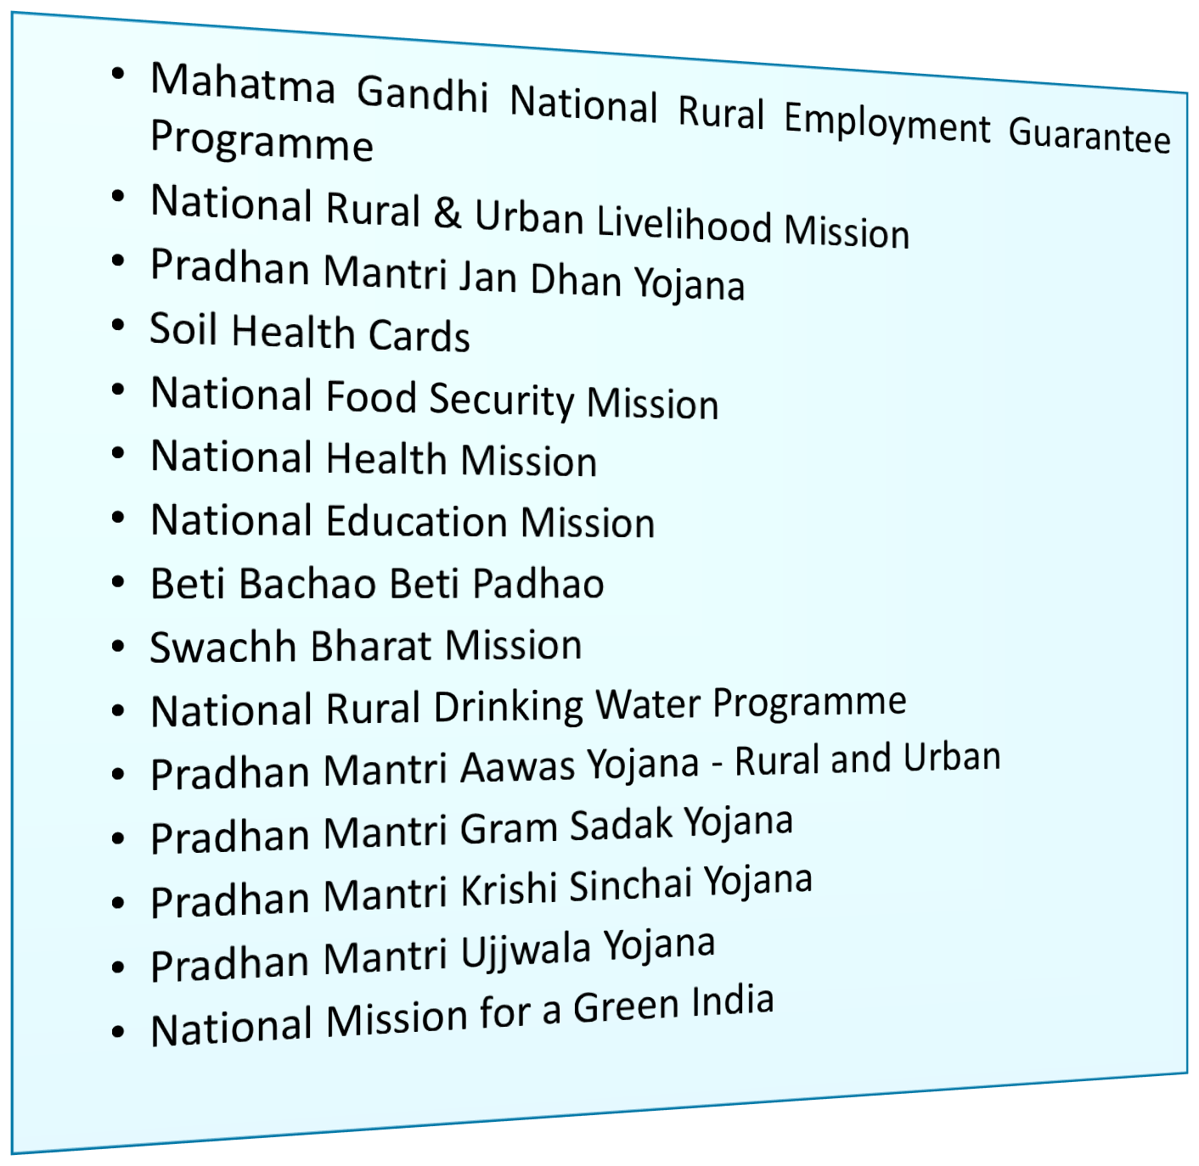
National Programmes/Initiatives aligned with SDGs
State Schemes/ Programmes

Slide 9
Other Central Ministries
Centrally Sponsored/Cent ral Sector Schemes
Nodal Ministries
SDGs & Targets
Mapping of SDGs & related Targets

Slide 10
SDGs and The Priority Indicators
 | SDGs | No. of Indicators | Focus Areas of Indicators
1 | No Poverty | 5 | population below poverty line & poverty gap ratio, employment under MGNREGA, Access to safe drinking water & Sanitation
2 | Zero Hunger | 5 | Access to food grains at subsidised prices Stunting & wasting in under-5 children Agricultural productivity & Gross Value Added per worker
3 | Good Health and Well-Being | 9 | Maternal Mortality Ratio; Neo-natal & Under-5 Mortality Rates Immunisation of under-2 children Incidence of HIV/AIDS, malaria & TB Medical personnel per 10,000 people
4 | Quality Education | 4 | Net Enrolment Ratio & Out of School Ratio Enrolment Ratio of Children with disabilities Pupil Teacher Ratio

Slide 11
SDGs and The Priority Indicators…
 | SDGs | No. of Indicators | Focus Areas of Indicators
5 | Gender Equality | 3 | Crime against women Women’s representation in Parliament, State Assembly & local bodies Use of family planning methods
6 | Clean Water and Sanitation | 2 | Access to potable water & sanitary toilet (Urban/Rural)
7 | Affordable and Clean Energy | 3 | Access to electricity & clean cooking fuel Share of renewable energy in total energy
8 | Decent Work and Economic Growth | 7 | Annual Growth Rate of GDP (PPP Per Capita) Annual Growth Rate of Manufacturing, Agriculture & MSME sector Unemployment & Work Force Participation Rate (M/F) Access to bank accounts & banking outlets

Slide 12
SDGs and The Priority Indicators…
 | SDGs | No. of Indicators | Focus Areas of Indicators
9 | Industry, Innovation and Infrastructure | 6 | % of rural population living within 2 km of an all-season road Share of manufacturing sector employment in total employment CO₂ emission per unit of value added R&D expenditure as % of GDP & No. of patents/IPRs filed Access to mobile phones.
10 | Reduced Inequalities | 2 | Income growth among the bottom 40% of People Representation of vulnerable groups in elected bodies
11 | Sustainable Cities and Communities | 3 | Slums/EWS settlements covered by formal housing Proportion of cities with efficient public transport & mobility Annual Mean levels of PM 2.5 & PM 10 in cities
12 | Sustainable Consumption and Production | 2 | Post harvest storage & distribution losses Adoption of Waste Management measures

Slide 13
SDGs and The Priority Indicators…
 | SDGs | No. of Indicators | Focus Areas of Indicators
13 | Climate Action | 2 | Number of states taking climate adaptive measures Achievement of Nationally Determined Contribution (NDC) Goals
14 | Life Below Water | 2 | No of sewage treatment plants and toilets constructed % Change in area under mangroves
15 | Life on Land | 4 | Proportion of forest area to total land area Total tree cover outside forest area Increase in Tree/ Forest cover in degraded areas % Increase in Net Sown Area
16 | Peace, Justice and Strong Institutions | 4 | % of people subjected to violence No. of human trafficking victims per 1,00,000 people No. of government online services provided Population covered under Aadhaar

Slide 14
Update from the States/UTs
In most States/UTs, Planning Department is the nodal department for implementation of SDGs.
Around 26 States/UTs have mapped the departments and interventions against the SDG targets.
15 States/UTs have drafted their Vision/Action Plan on SDGs. For 9 others it is under process.
12 States/UTs have initiated the process of setting up a monitoring framework on SDGs; 4 States already have a system in place.
Around 19 States/UTs have had held some form of consultation on SDGs.
35

Slide 15
Ways Forward
SDG Baseline (keeping 2016 as the base year) prepared at State and National levels
Functioning knowledge hub with regular documentation and dissemination of best practices SDG wise
Establishment of the monitoring system and dashboard at the national & State levels
Regular Capacity Development of identified stakeholders at State and district levels
Regular Reporting system at national & State levels on SDG status
Localization of SDG Implementation: State/District level implementation with involvement of multiple stakeholders
41

Slide 16
Action Points for the States/UTs
SDG wise mapping of schemes, departments and budgets for all the goals and targets
Identifying indicators for schemes wherever needed
Identifying data sources & nodal officials for collecting/managing data
Analysing adequacy of current interventions, identifying critical gaps & devising suitable interventions.
Convergence of all departments & stakeholders in planning at Panchayat, Block & district levels
Training/Capacity Building (State, District, Block & Panchayat) for implementation & monitoring.
Reviewing the performance of districts on the priority indicators.
Regular update to NITI Aayog on the progress under priority indicators as well as the related schemes.

Slide 17
43

