Slide 1
Investment Process
Dr. Manish Dadhich

Slide 2
When to start Investing?
The sooner one starts investing the better. By investing early you allow your investments more time to grow, whereby the concept of compounding increases your income, by accumulating the principal and the interest or dividend earned on it, year after year.
The three golden rules for all investors are:
Invest early
Invest regularly
Invest for long term and not short term

Slide 3
Before making any investment, one must ensure to:
1. Obtain written documents explaining the investment
2. Read and understand such documents
3. Verify the legitimacy of the investment
4. Find out the costs and benefits associated with the investment
5. Assess the risk-return profile of the investment
6. Know the liquidity and safety aspects of the investment
What care should one take while investing?

Slide 4
7. Ascertain if it is appropriate for your specific goals
8. Compare these details with other investment opportunities available
9. Examine if it fits in with other investments you are considering or you have already made
10. Deal only through an authorized intermediary
11. Seek all clarifications about the intermediary and the investment
12. Explore the options available to you if something were to go wrong, and then, if satisfied, make the investment.
These are called the twelve important steps to investing.
CONT..

Slide 5
Non- marketable. bond or fixed income . mutual funds. real estate.
Equity. gold/silver/precious metals/stones. money market. commodity market.
Various Types of Investments

Slide 6
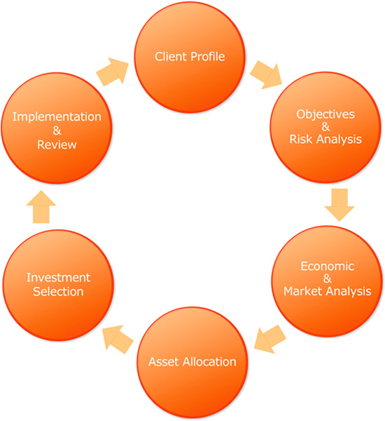
Investment Cycle

Slide 7
A person, company, etc., That seeks the advice of a professional man or woman a person depending on another's patronage how to know the investor?
Gain the personnel information of client.
Find the need of the investor.
Financial status of investor.
Time period investor is having to achieve that goal.
Understand the risk appetite of the investor.
Client Profile

Slide 8
Objective should vary from person to person.
Like daughter marriage.
Building dream home.
Children education.
Objective of investment should be ethical.
Both for long term and short term.
AS WE KNOW THERE ARE THREE TYPES OF INVESTOR conservative, moderate, aggressive
Objective and Risk analysis.

Slide 9
Analysis of market and economic condition is very important . various economic and market factor inflation . different rates.
Historical market trend.
Performance of particular scheme where you are going to invest.
Etc……….
Economic and Market analysis

Slide 10
A systematic approach to investing among different categories of investments. It determine the best way to divide investable assets into the various types of asset classes: diversification : investing in a number of different investments, to reduce the overall risk of investments.
Asset Allocation

Slide 11
After doing all now select the investment which fulfill your objective , goals, need, time and risk and than implement it.
Investment selection and Implementation

