Slide 1
Risk & Return Relationship
Dr. Manish dadhich

Slide 2
TOTAL RISK
The total variability in returns of a security represents the total risk of that security. Systematic risk and unsystematic risk are the two components of total risk. Thus
Total risk
= Systematic risk + Unsystematic risk

Slide 3
Risks associated with investments
Risks
Non – systematic OR diversifiable
Systematic OR Non diversifiable

Slide 4
SYSTEMATIC RISK
The portion of the variability of return of a security that is caused by external factors, is called systematic risk.
It is also known as market risk or non-diversifiable risk.
Economic and political instability, economic recession, macro policy of the government, etc. affect the price of all shares systematically. Thus the variation of return in shares, which is caused by these factors, is called systematic risk.

Slide 5
Systematic Risks
Risk due to inflation
Interest
rate risk
Political risk
Market risk
Risk due to govt. policies
Natural calamities
Industrial
growth
monsoon
scams
International
events
War like
situation

Slide 6
NON - SYSTEMATIC RISK:
The return from a security sometimes varies because of certain factors affecting only the company issuing such security. Examples are raw material scarcity, Labour strike, management efficiency etc.
When variability of returns occurs because of such firm-specific factors, it is known as unsystematic risk.

Slide 7
Non – Systematic Risks
Non systematic
risks
Business
risks
Financial
risks
Risks due to uncertainty
Disputes

Slide 8
RISK RETURN RELATIONSHIP OF DIFFERENT STOCKS
Rate of
Return
Market Line E(r)
Risk
Premium
Ordinary shares
Preference shares
Subordinate loan stock
Unsecured loan
Debenture with floating charge
Mortage loan
Government stock (risk-free)
Degree of Risk
Risk return relationship of different stocks

Slide 9
Risk & Return Analysis
Return on security(single asset) consists of two parts:
Return = dividend + capital gain rate
R = D₁ + (P₁ – P₀) P₀
WHERE R = RATE OF RETURN IN YEAR 1
_{D}1 _{= DIVIDEND PER SHARE IN YEAR 1}
P0 = PRICE OF SHARE IN THE BEGINNING OF THE YEAR
P1 = PRICE OF SHARE IN THE END OF THE YEAR

Slide 10
Average rate of return
R = 1 [ R₁+R₂+……+R_{n}]
n
R = 1 Σ R_{t}
n t=1
Where
R = average rate of return.
R_{t} = realised rates of return in periods 1,2, …..t
n = total no. of periods
n

Slide 11
Risk
Risk refers to dispersion of a variable.
It is measured by variance or SD.
Variance is the sum of squares of the deviations of actual returns from average returns .
Variance = Σ (R_{i –} R)²
SD = (variance²)^{1/2}

Slide 12
Expected rate of return
It is the weighted average of all possible returns multiplied by their respective probabilities.
E(R) = R1P1 + R2P2 + ………+ RnPn
E(R) = Σ R_{i} P_{i}
_{i}=1
Where R_{i} is the outcome i, P_{i} is the probability of occurrence of i.
n

Slide 13
Variance is the sum of squares of the deviations of actual returns from expected returns weighted by the associated probabilities.
Variance = Σ (R_{i –} E(R) )^{2*} P_{i}
i=1
SD = (variance²)^{1/2}
n

Slide 14
Portfolio
A portfolio is a bundle of individual assets or securities.
All investors hold well diversified portfolio of assets instead of investing in a single asset.
If the investor holds well diversified portfolio of assets, the concern should be expected rate of return & risk of portfolio rather than individual assets.

Slide 15
Portfolio return- two asset case
The expected return from a portfolio of two or more securities is equal to the weighted average of the expected returns from the individual securities.
= WA (RA) + WB (RB)
Where,
= Expected return from a portfolio of two securities
WA = Proportion of funds invested in Security A
WB = Proportion of funds invested in Security B
RA = Expected return of Security A
RB = Expected return of Security B
WA+ WB = 1
Σ(Rp)
Σ(Rp)

Slide 16
Portfolio risk- two asset
Since the securities associated in a portfolio are associated with each other, portfolio risk is associated with covariance between returns of securities.
Covariance_{xy} = Σ (R_{xi –} E(Rx) (R_{yi –} E(Ry)*P_{i}
i=1
n

Slide 17
Correlation
To measure the relationship between returns of securities.
Cor_{xy} = Cov_{xy}
SD_{X} SD_{Y}
the correlation coefficient ranges between –1 to +1.
The diversification has benefits when correlation between return of assets is less than 1.

Slide 18
DIVERSIFICATION OF RISK
We have seen that total risk of an individual security is measured by the standard deviation (σ ), which can be divided into two parts i.e., systematic risk and unsystematic risk
Total Risk (σ) = Systematic Risk + Unsystematic risk

Slide 19
Unsystematic Risk
Systematic Risk
Number of security
Figure 1: Reduction of Risk through Diversification
Risk

Slide 20
Only to increase the number of securities in the portfolio will not diversity the risk. Securities are to be selected carefully.
If two security returns are less than perfectly correlated, an investor gains through diversification.
If two securities M and N are perfectly negatively correlated, total risk will reduce to zero.
Suppose return are as follows:
 | t₁ | t₂ | t₃ | t₄
M | 10% | 20% | 10% | 20%
N | 20% | 10% | 20% | 10%
Mean Return | 15% | 15% | 15% | 15%

Slide 21
20% M
10% N
Figure 2
If r = -1 (perfectly negatively correlated), risk is completely eliminated (σ = 0)
If r = 1, risk can not be diversified away
If r < 1 risk will be diversified away to some extent.

Slide 22
TWO IMPORTANT FINDINGS:
More number of securities will reduce portfolio risk
Securities should not be perfectly correlated.

Slide 23
Returns distribution for two perfectly negatively correlated stocks (ρ = -1.0)
Stock W
Stock M
Portfolio WM
25
25
25
15
15
15
0
0
0
-10
-10
-10

Slide 24
Returns distribution for two perfectly positively correlated stocks (ρ = 1.0)
Stock M
Stock M’
Portfolio MM’
25
25
25
15
15
15
0
0
0
-10
-10
-10

Slide 25
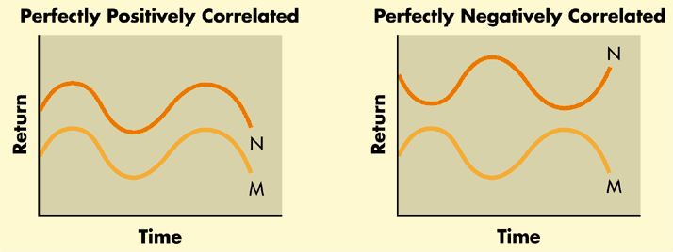
Diversification….does it always work?
Diversification is enhanced depending upon the extent to which the returns on assets “move” together.
This movement is typically measured by a statistic known as “correlation” as shown in the figure below.

Slide 26
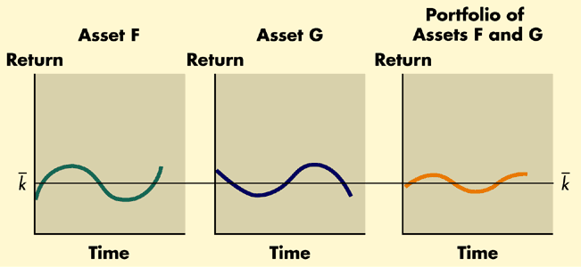
Even if two assets are not perfectly negatively correlated, an investor can still realize diversification benefits from combining them in a portfolio as shown in the figure below.

